Slide 1
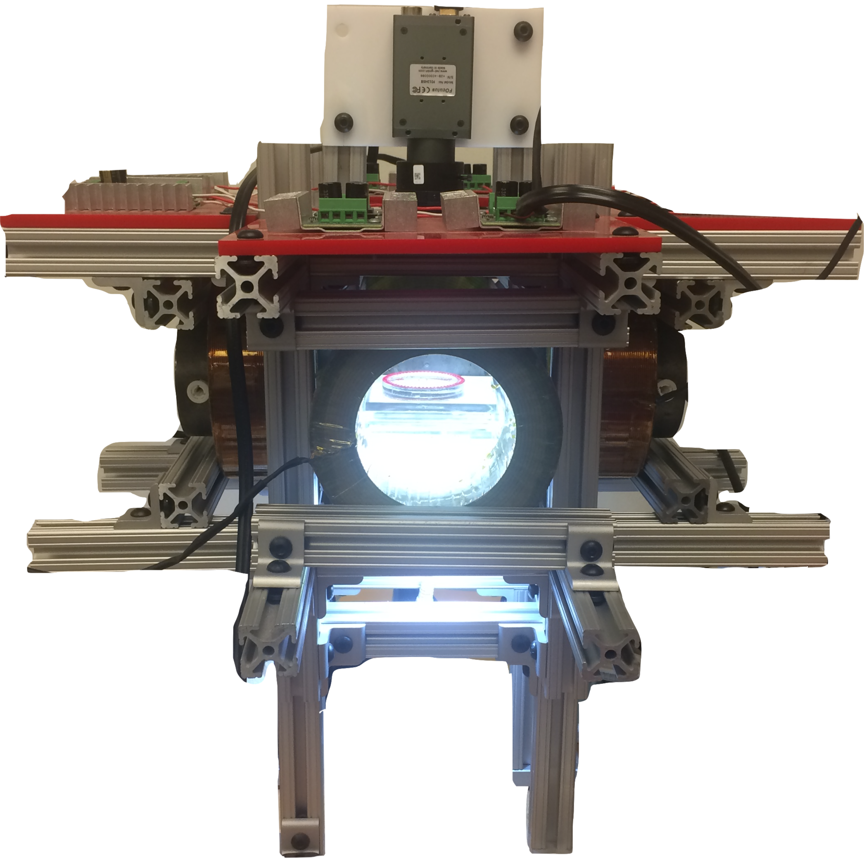
camera
5 cm
coil
coil
workspace
LED

